Slide 1

RWANDA LABOUR FORCE SURVEY, 2022
Interactive dashboard
This dashboard enlightens a user on key indicators of Rwanda's labor landscape, serving as a comprehensive guide to the nation's employment dynamics. It gives clear overview about labor force during year of 2022.

Slide 2
Aims of the Dashboard
The aim of the dashboard is to provide a comprehensive overview of key labor force indicators in Rwanda, 2022. it focuses on the following main indicators:
01
Labor underutilization
- understand and analyze data on various dimension of labor underutilization.
- Explore information on individuals who are unemployed, underplayed.
02
Employment to population ratio
- Examine the proportion of the working age population that is employed
- Highlight the trends and variations in employment-to-population ratio across different demographic groups.
03
Unemployment Rate
- Track and Visualize unemployment rate over time.
- Provide insights into the percentage of the labor force that is actively seeking employment but is currently unemployed.
04
Workforce occupation
. - Present data on distribution of the workforce across various occupations.
- Identify key sectors and occupations that contribute significantly to employment.

Slide 3

The Intended Audience
1st
The policy makers
4th
International Organizations.
Government officials and policymakers can use the dashboard to make informed decisions related to labor market policies, employment strategies, and workforce development.
Entities such as the International Labor Organization (ILO) can use the dashboard to gain the insights into Rwanda’s labor market dynamics and provide support for targeted interventions.
2nd
Researchers and Analysts
5th
Educational institutions
Labor market researchers and analysts can explore the data to identify trends, patterns, and correlations in labor force indicators, contributing to academic research and policy analysis.
Students, educators, and researchers in the field of economics, labor studies, and social sciences can access the dashboard for educational purposes and to enhance their understanding of labor market concepts.
3rd
Government Agencies
6th
General public
Ministries and government agencies responsible for labor and employment can utilize the dashboard to monitor key indicators and assess the effectiveness of existing programs and initiatives.
The dashboard is designed to be accessible to the general public, allowing citizens to stay informed about the state of the labor market in Rwanda. It promotes transparency and public awareness.

Slide 4
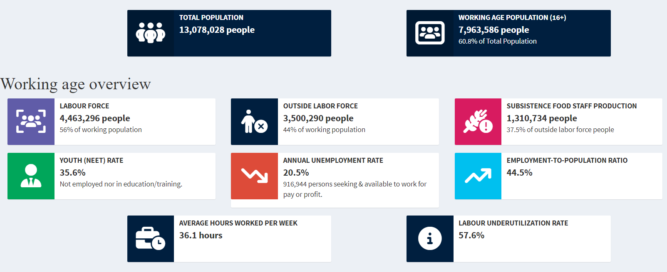
General overview

Slide 5
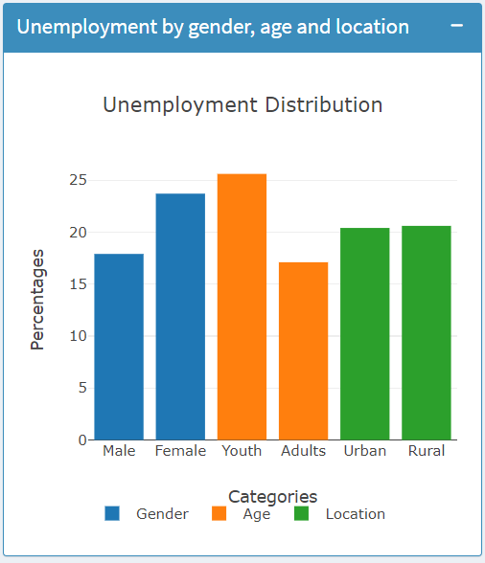
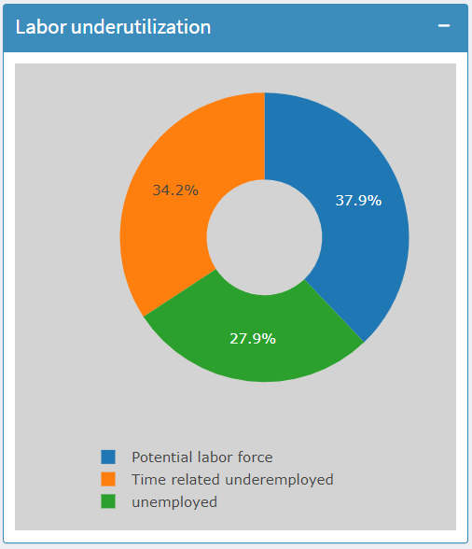
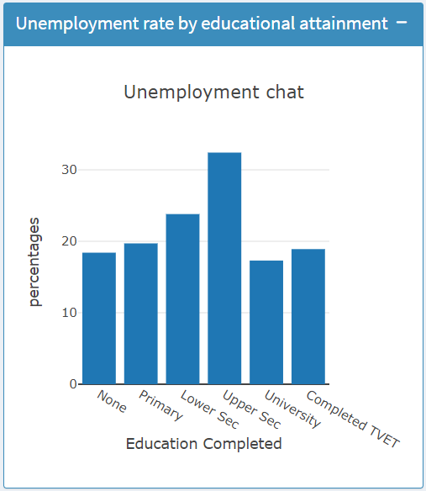
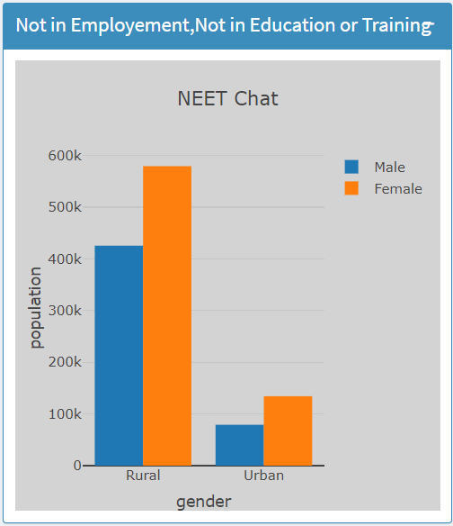
Illustration of main Indicators.
.

Slide 6
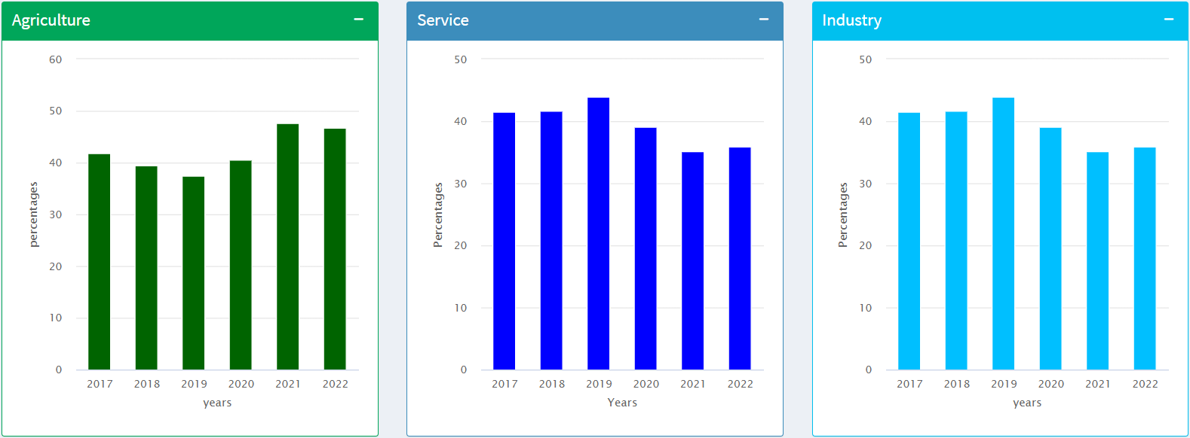
Time series data for branch of economic activities

Slide 7
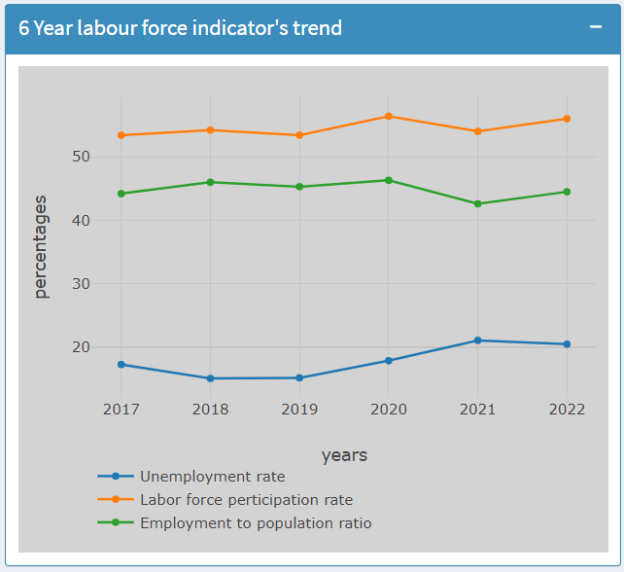
Longitudinal time series trend

Slide 8

Labor Statistics Trends (2017-2022) Source: https://www.statistics.gov.rw/publication/1919

